Slide 1
Lands End
Basket Page USPs

Slide 2
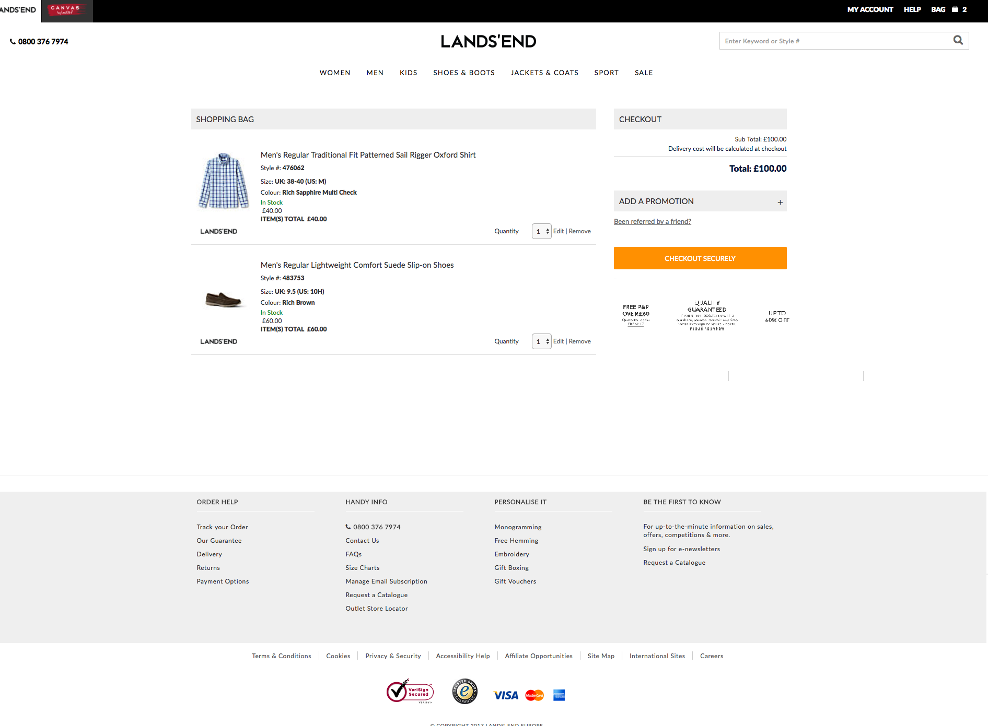
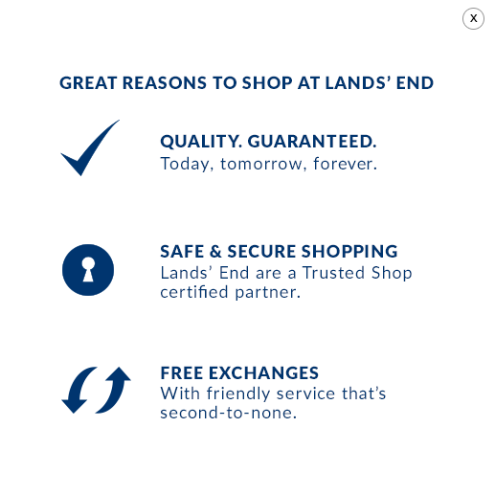
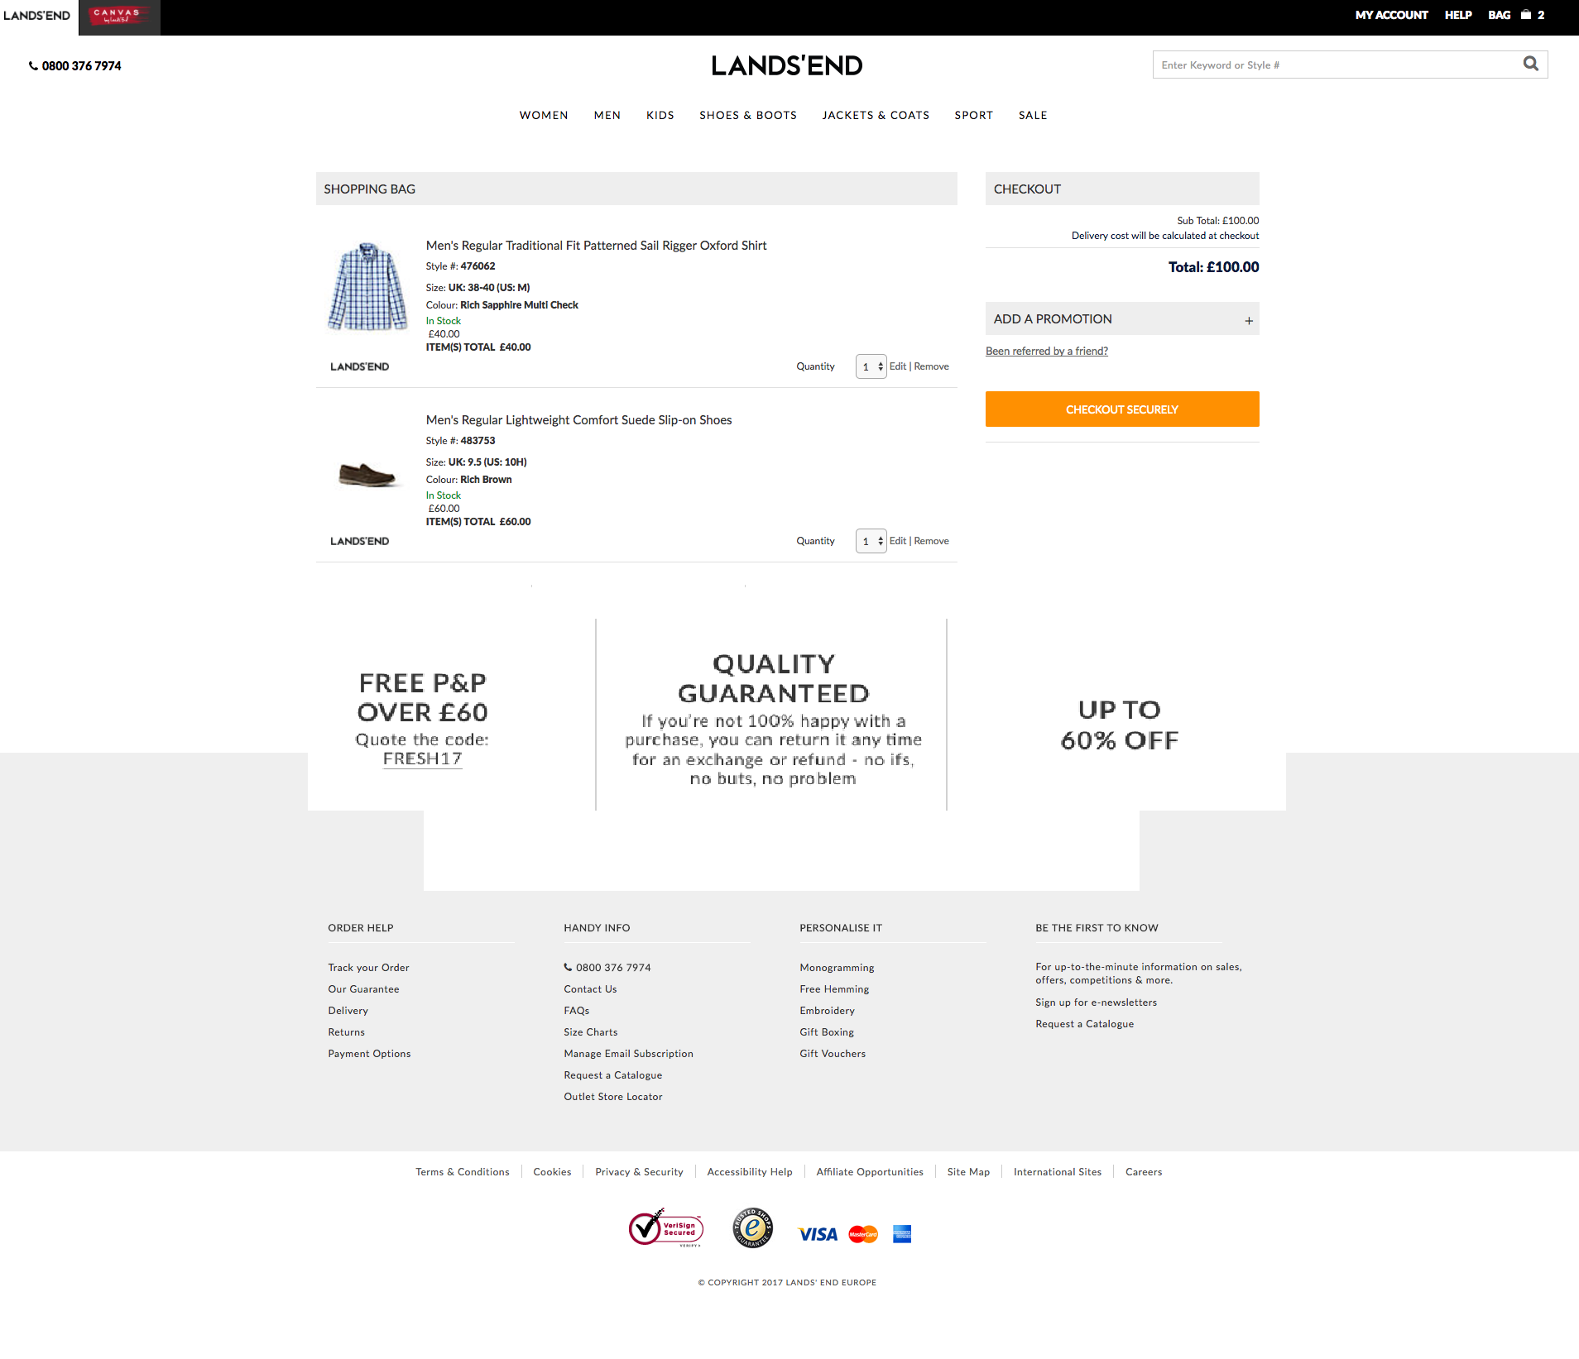
V1
Replace USP Content with the above.
V1 – Implement banner below CTA
V2 – Implement banner full width.
V2

